Slide 1
SAIKS 2022 final presentation
Bogdan Bordeianu, Filip Kovacevic, Nino Ziegelwanger
Notes:
1

Slide 2
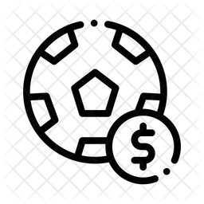


Application Domain
Football information system with betting capabilities Information about: Game results, transfers, clubs, teams, players, seasons, infrastructures, … But also: Bets on games, betting providers and their offered quotes User Accounts needed to place bets but: Football associates (players, club managers, referees) cannot place bets

Slide 3
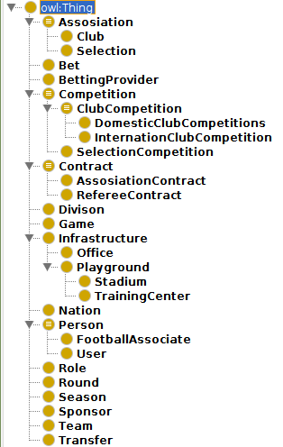
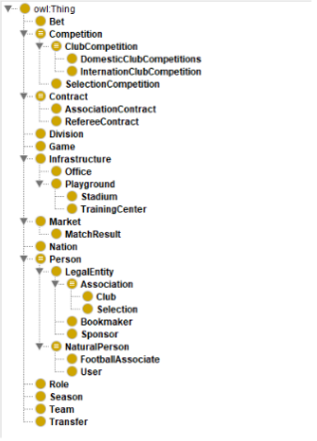
Football ontology members
Notes:
<number>

Slide 4






Ontop Mappings
Bets
transfers
Ontop mappings
Insert into normalized postgres schema
Over 60.000 triples including inferred triples
betting_ods
df_full_premierleague
https://github.com/GreenfishK/SAIKS

Slide 5
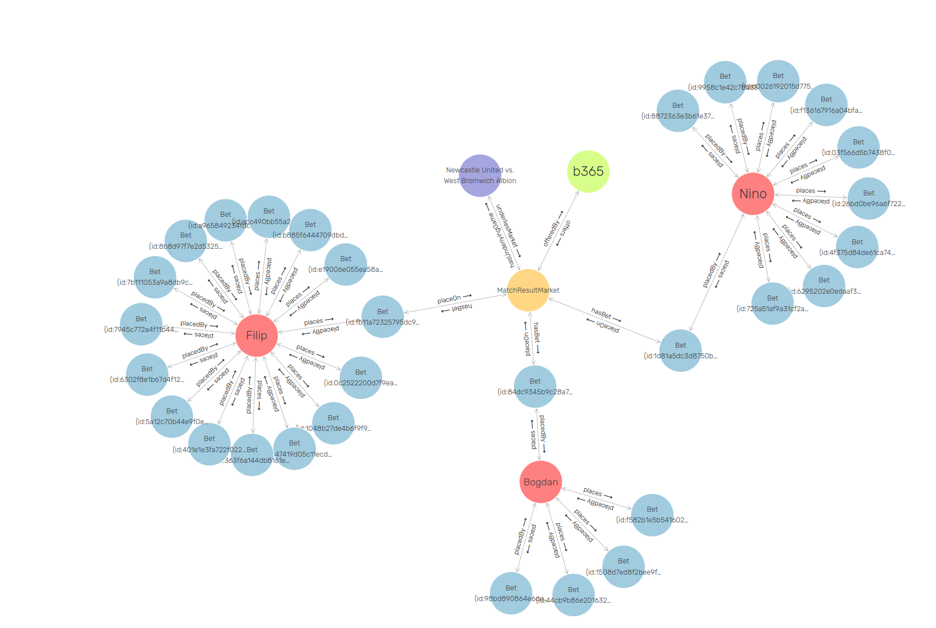
Football ontology in GraphDB
Notes:
<number>

Slide 6
SHACL(1)
Tip Constraint
If placed on a Match Result Market → String pattern “A|H|D”
If placed on another Market → String pattern “.*”
Quotes Constraint (for all quotes)
minExclusive 1
Password Constraint
Exactly 1
minLength 8

Slide 7
SHACL(2)
Nation Constraint
Exactly 1 Address
Must be a String or an Address Class
Association Contract Constraint
Exactly 1 Role
Min 1 Season
Exactly 1 Association
Exactly 1 FootballAssociate

Slide 8
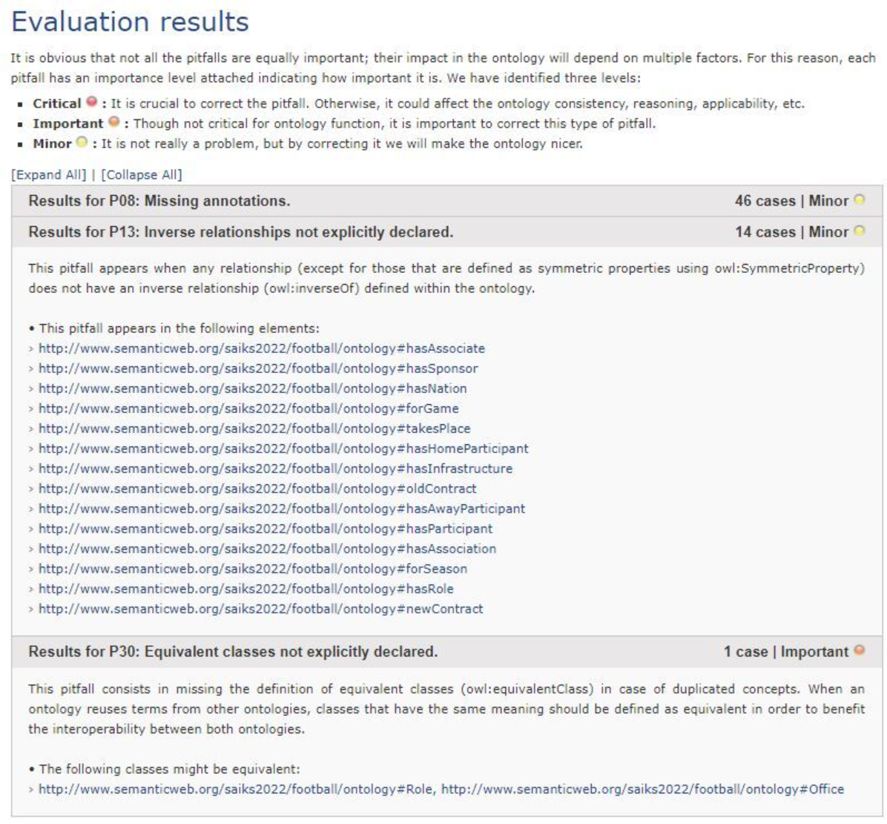
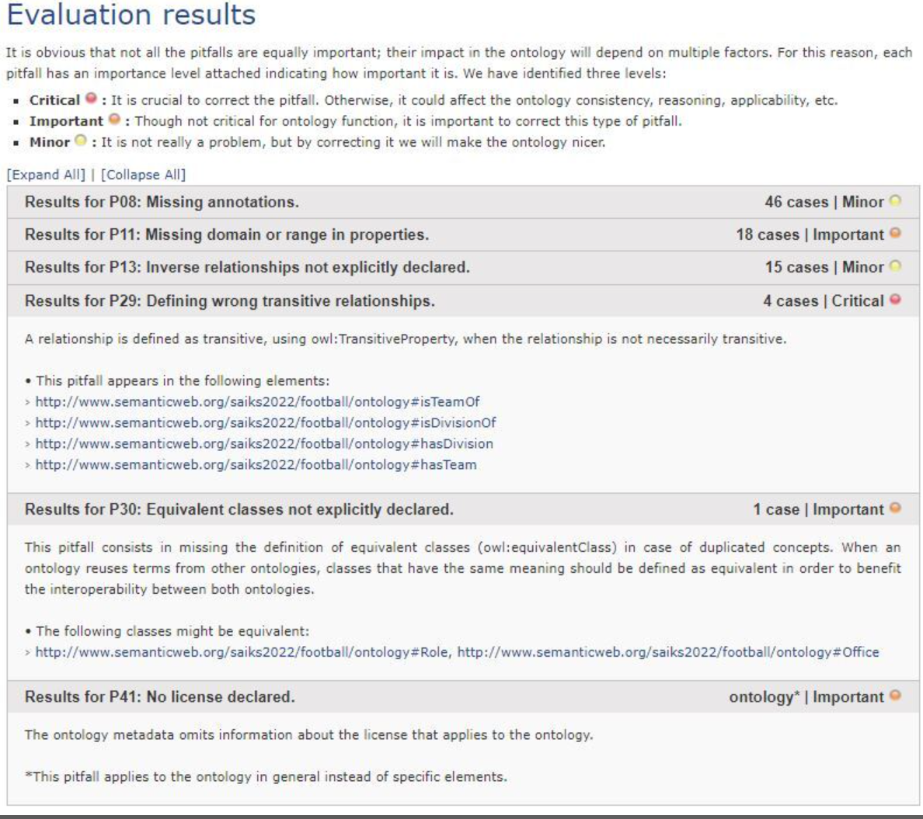
Oops! (Before and after)

Slide 9
Ontology Alignment – Our experience
* Two different ontologies found.
- Different complexities
- No betting concepts in the second ontology
* Used Logmap and AgreementMaker
- Only Logmap was able to deliver a result for only one of the two ontologies
- One similar class found
* Matched classes do not have the same semantics
- Our Person class also includes legal bodies while the other does not

Slide 10
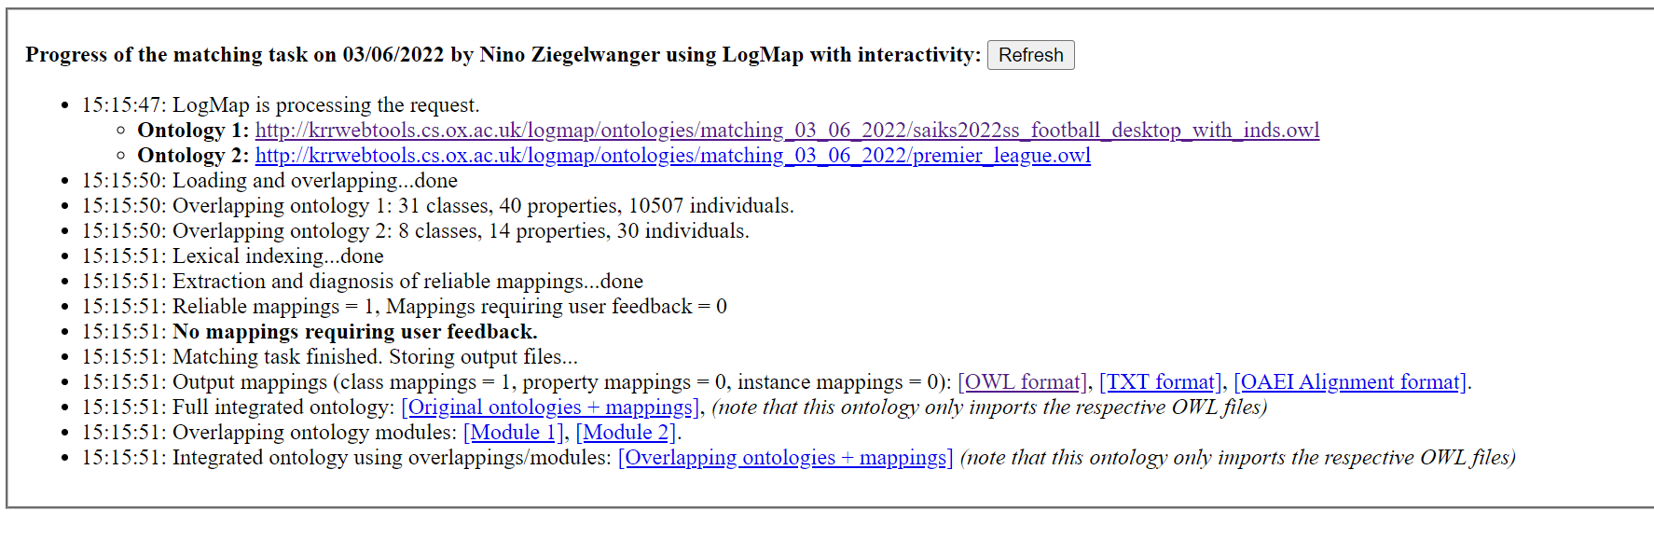
Ontology Alignment

Slide 11
Questions?
Notes:
11

